Slide 1

ProdigyPort
“Your digital portfolio, made easy”

Slide 2
Introduction
Research
How Might We question
Solution
Branding
Demo

Slide 3
Research
Interviews:
Students having difficulties creating a portfolio:
Confusing.
Hard to access.
Structuring can be difficult.
No reminders and notifications.
Can not do anything on the go.
No motivation to keep going.
Hard to put photos, videos and audio.
No way to track actual progress.

Slide 4
How Might We question
A How Might We question opens up brainstorming and other ideation session. Therefore, we came up with the following question:
"How might we create a mobile solution that can help students easily
create a portfolio with less effort?"

Slide 5
Solution
Smart mobile application:
Allows for structured and organized portfolio creation.
Easy to navigate around and easy to understand how it works.
Easy to access, since everybody has a smart phone.
Easy to add photos, videos and audio.
Can use it on the go.
Get notifications and reminders.
Progress system.

Slide 6
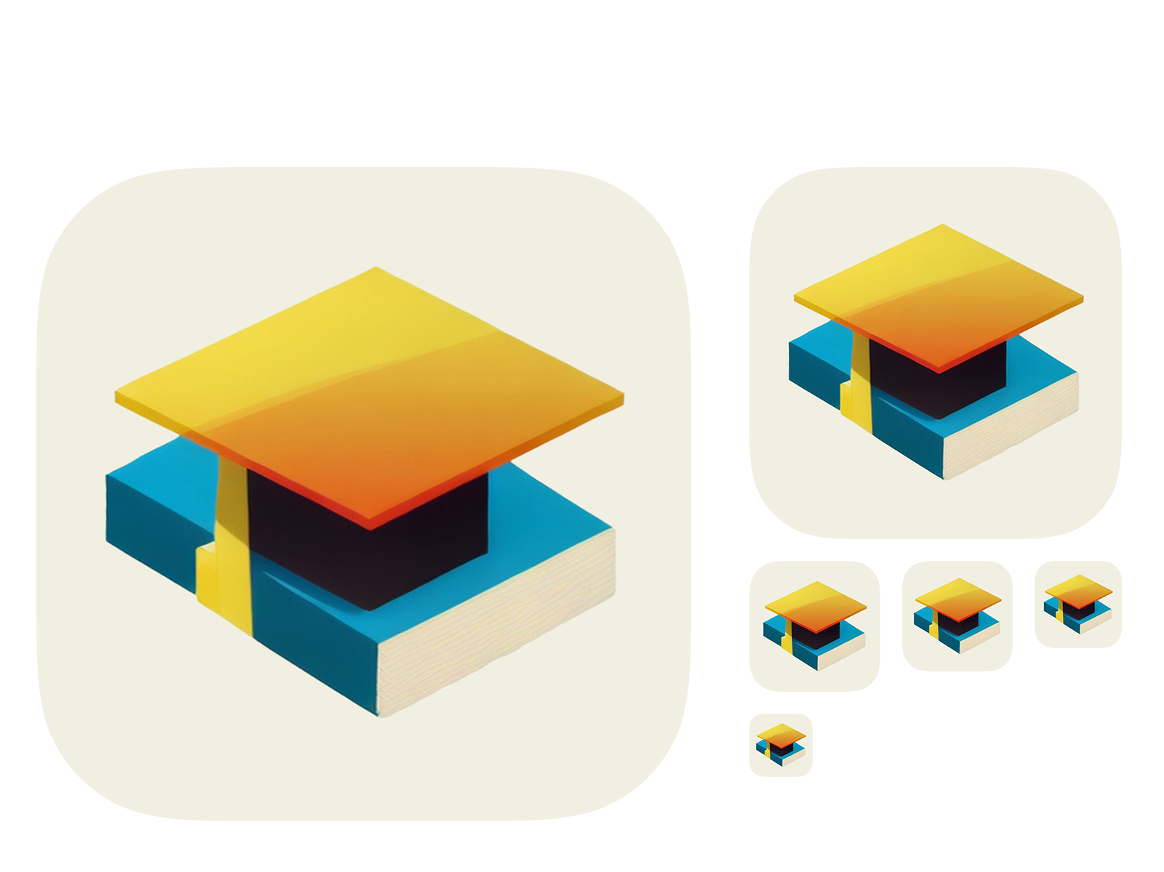
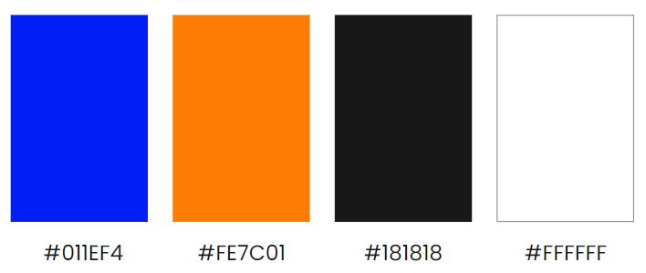
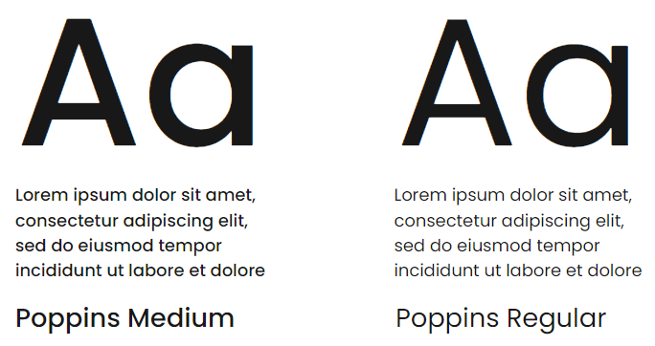
Branding

Slide 7
Demo
Figma wireframe
Android/IOS prototype

